Slide 1
XAI presentation Team 2 – Dataset 4
Pisa, 04/03/2024
Authors:
Consoloni Marco
Dalla Noce Niko
Genovese Donatella

Slide 2
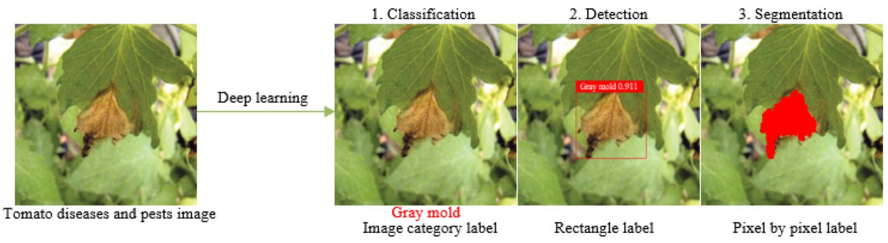
Plant Disease Detection Domain
It is a technology that uses vision sensors to capture images.
We use ML techniques to determine whether diseases and pests are present in the collected images.
Pant disease and pest detection task can be broken down in three different levels: “what”, “where” and “how”.
This field of study is useful for:
Promptly detecting plant diseases during initial phases of infection, with symptoms often imperceptible.
Tracking the advancement of the disease, to apply the appropriate management strategies.

Slide 3
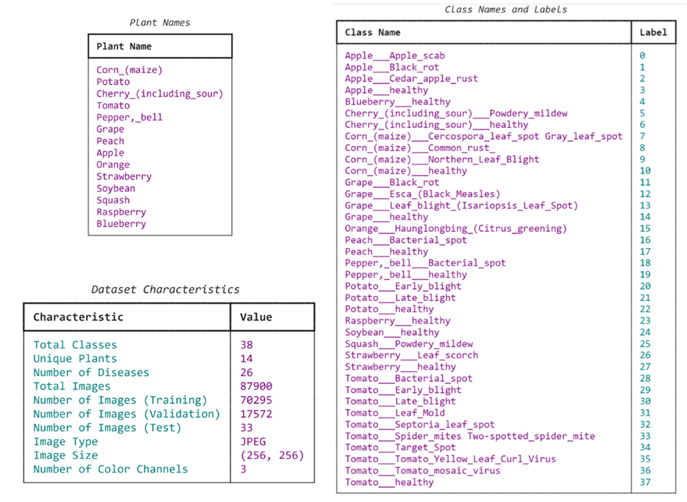
Plant Disease Dataset
The dataset contains approximately 87K 256x256 RGB images.
It includes both healthy and ill leaves from 14 different plant species, classified into 38 distinct categories.
Training set consists of approximately 70K instances.
Validation set has roughly 17K, and the test set only 33.
Dataset is balanced.
Main characteristics of Plant Disease Dataset

Slide 4
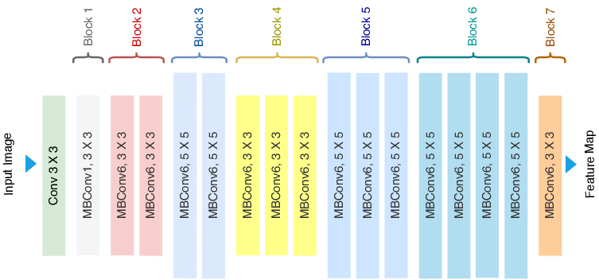
ML model for image classification
We use EfficientNet “B0” CNN model for classifying images. It has 4,1 M of params.
Explain a model with good performance.
We trained two different models: one from scratch and the other using pre-trained weights.
Training hyperparameters:
Adam optimizer with a learning rate of 8e-4.
50 epochs for the “scratch” model.
10 epochs for the “pre-trained” model.
Cross entropy loss with a 0.1 probability of label smoothing.
Cosine learning scheduler.
Cumulative batch size of 1024.
EfficientNet architecture.
Accuracy % | Scratch | Pre-trained
TRAIN set | 99,97 | 99,99
VALID set | 99,65 | 99,94
TEST set | 100 | 100
Accuracy of the two trained models.

Slide 5
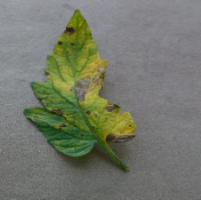

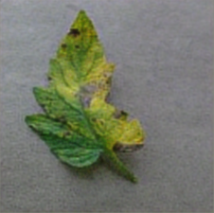
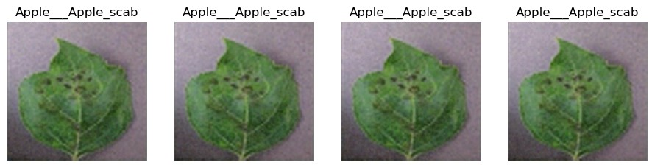

Autoencoder model for ABELE
Consists of four convolutional layers on both the encoder and the decoder modules.
Latent dimension of 64x32x32 and 128x32x32
Training hyperparameters:
Adam optimizer with a learning rate of 2e-3.
30 epochs.
Mean Squared Error loss.
Cumulative batch size of 1024.
ABELE generates counterexamples of the same class as the image to explain.
Original image.
Reconstructed image
64x32x32 latent dim.
Reconstructed image
128x32x32 latent dim.
ABELE getCounterExamples() output.

Slide 6
Case studies
Case 1: Misclassified images
Case 2: Non-Homogeneous background
Case 3: Low Confidence Predictions
Case 4: High Confidence Predictions
Case 5: Similar images
Case 6: Multi-leafed images

Slide 7
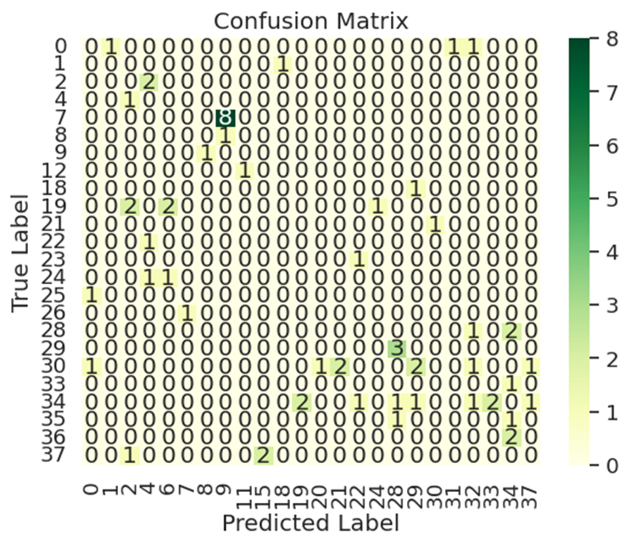
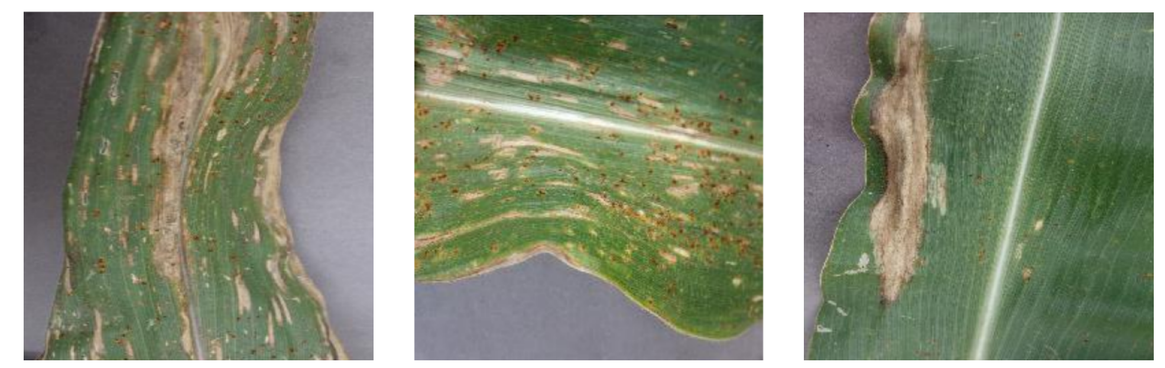
Case study 1 : Misclassified images
Motivations: We notice that the highest number of misclassified images occurs with class 7, "Corn (maize) Cercospora leaf spot", which is wrongly predicted as class 9, "Corn (maize) Northern Leaf Blight".
Label: Corn (maize) Cercospora
leaf spot (7) Prediction: Corn (maize) Northern
leaf blight (9)
Prediction probability: 0.91
Label: Corn (maize) Cercospora
leaf spot (7) Prediction: Corn (maize)
Cercospora Leaf spot (7)
Prediction probability: 0.91
Label: Corn (maize) Northern leaf blight (9) Prediction: Corn (maize) Northern Leaf blight (9)
Prediction probability: 0.91
Notes:
Motivations: We choose this expample because from the confusion Matrix we can see that there are 8 instances from class 7 that are misclassified as class 9, hence it suggests that probably there could be a misunderstanding of the model on some particular images from this class. Hence we decide to apply XAI techniques on a misclassified image and, for comparison we also select two images correctly classified with high confidence from class 9 and 7.

Slide 8
Case study 1 : Misclassified images
Observations:
Cercospora leaf spot (7) is characterized by circular lesions in its initial stages, that over time, may merge forming irregular shapes.
Nothern Leaf Blight (9) is characterized by cigar-shaped or elliptical lesions, initially appearing as small, grayish-green spots with tan centers.
Label: Corn (maize) Cercospora
leaf spot (7) Prediction: Corn (maize) Northern leaf blight (9)
Prediction probability: 0.91
Label: Corn (maize) Cercospora
leaf spot (7) Prediction: Corn (maize)
Cercospora Leaf spot (7)
Prediction probability: 0.91
Label: Corn (maize) Northern leaf blight (9) Prediction: Corn (maize) Northern Leaf blight (9)
Prediction probability: 0.91

Slide 9
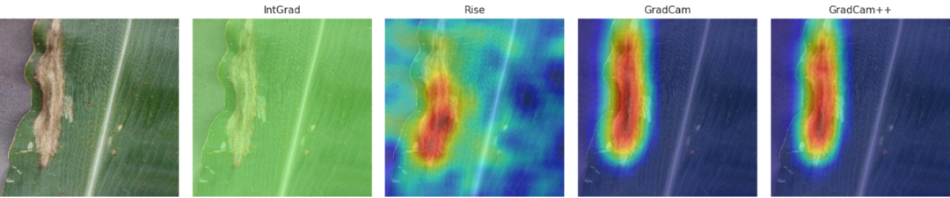
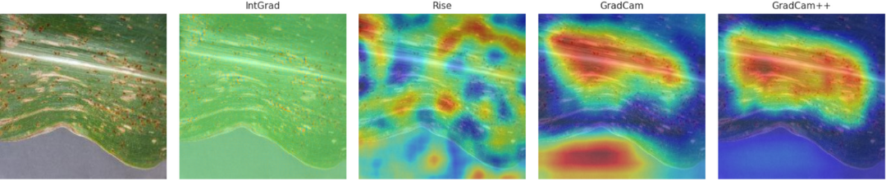
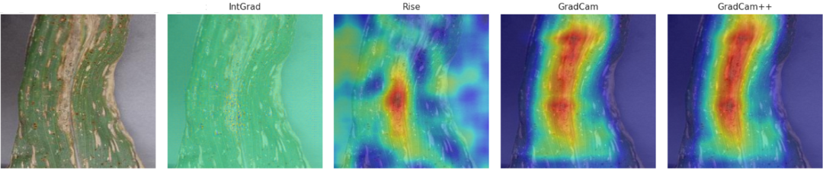
Case study 1 : Misclassified images
Results:
Nothern Leaf Blight (9): All the methods highlight the cigar-shaped lesion.
Cercorspora Leaf Spot (7): All methods reveal diverse focal points across the image, indicating a lack of clear discriminative features.
Misclassified image: All methods converge on the centre of the image.
Results of explainability techniques for Northern leaf blight (9)
Results of explainability techniques for Cercospora Leaf Spot (7)
Results of explainability techniques for Misclassified image
Notes:
We analyze the XAI with the following techniques: IntGrad, Rise, GradCam, GradCam++. We don’t use LIME because it doesn’t work well due to difficulties in generating a segmentation meaningful segmentation mask.
●Class 9 correctly classified: All methods highlight the cigar-shaped lesion which is characteristic for this type of disease.
●Class 7 correctly classified: Here the typical characteristic for this disease are: circular lesions in its initial stages, that over time, may merge, forming irregular shapes.
The XAI outputs reveal diverse focal points across the image, indicating a lack of clear discriminative features
●Misclassified image: XAI techniques converge on the center of the image, similar to the cigar-shaped lesion characteristic of Class 9

Slide 10
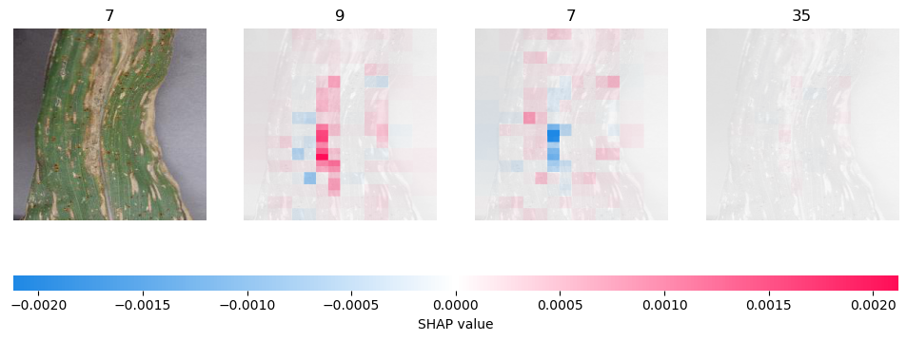
Case study 1 : Misclassified images
SHAP analysis: SHAP is consistent with the other methods but give also regions that contributes for the prediction with class 7 and class 35 (which are the first three class with highest probability prediction values).
Conclusion: When the circular lesions typical of Cercospora Leaf spot merge, the model mistakes them for the classic cigar-shaped lesions of Northern Leaf Blight.
SHAP explanation for misclassified image
In-depth further analysis: Deep investigation on Class 7 discriminative features.
Notes:
Shap: We conduct further analysis using SHAP which highlight the pixels that contributes the most for the classification of the first three class with highest probability, as we see the first class is 9 and, more or less, are highlighted the pixel in the centre, the second most likely image is the correct class, while the third is the one with the lowest probability of being correctly classified. The probability is so low that we cannot even distinguish the red sections from the blue ones.
Conclusion: When the circular lesions typical of Cercospora Leaf spot merge, the model mistakes them for the classic cigar-shaped lesions of Northern Leaf Blight.
Further investigations: A lack of clear discriminative features for Class 7 suggests further investigation in this path. This could involve the analysis of different images from that class to uncover common patterns reflected in heat maps. It could also be useful to compare these analysis combining various tasks such as plant-specific classification or distinguishing healthy from non-healthy plants.

Slide 11
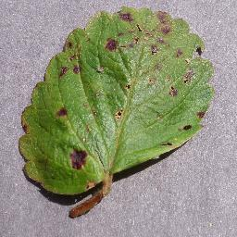
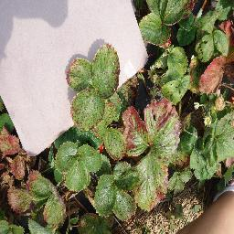
Case study 2 : Non-Homogeneous Background
Motivations: In real-world scenarios images may exhibit non-homogenous backgrounds. Is our model capable of accurately classifying disease manifestations directly on the plant, regardless of background complexity?
Homogeneous Background
Non-Homogeneous Background

Slide 12
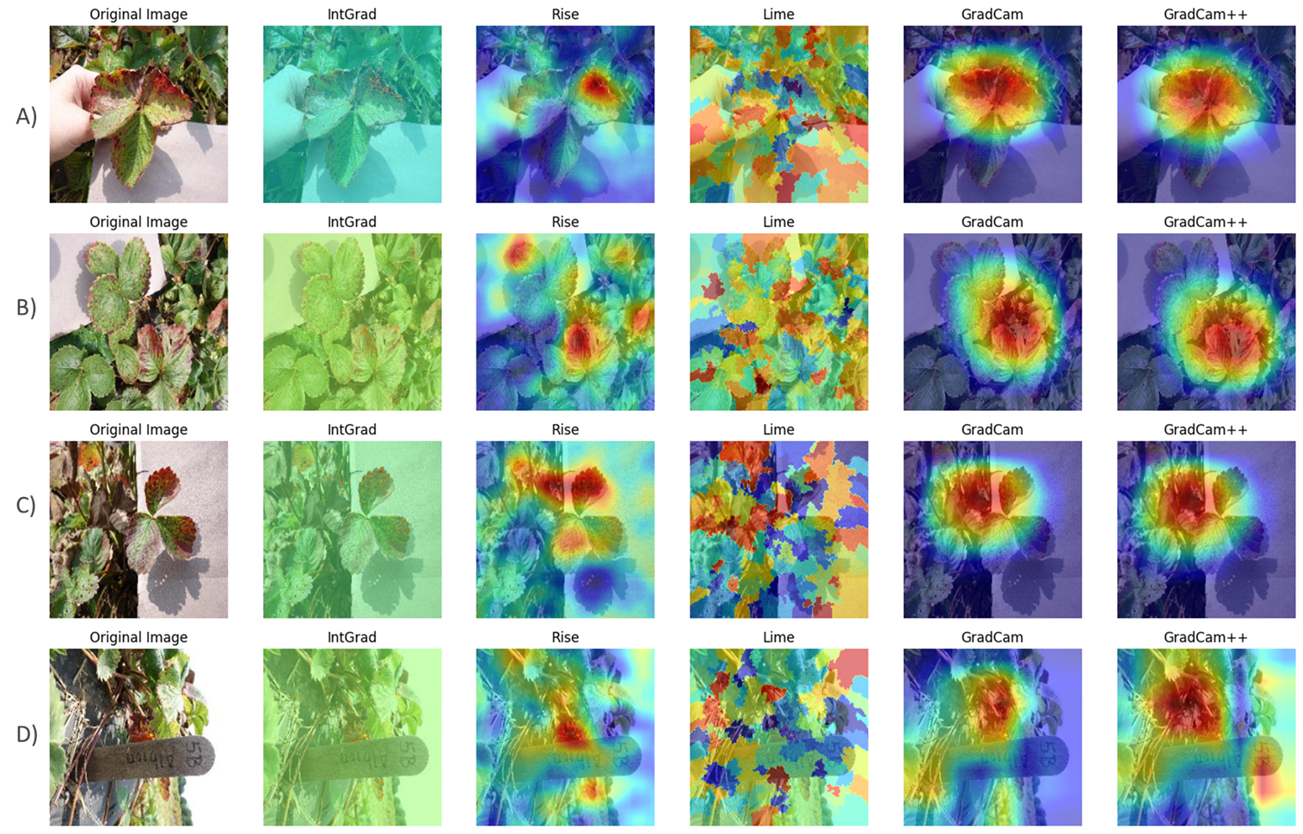
Case study 2 : Non-Homogeneous Background
Notes:
●images belonging to the class ”Strawberry Leaf scorch (26)”, as the class ”Strawberry Leaf scorch (26)”, is unique among the dataset classes in presenting such non-homogeneous background.
●Lime method fails to capture distinctive features of the leaf scorch disease. The high-valued superpixels identified by Lime do not correspond to the disease symptoms.
●when examining images A and B, both Intagrad and Rise methods appropriately focus on the relevant areas of the images and it seems that the methods are able to capture the symptoms of the disease’s not only on the leaf on the foreground but also on the leaves on the background of the image.
●Image D reveals some other limitations of our model. Image D does not depict a single leaf; according to the saliency maps, the model appears to concentrate on a group of stems in the foreground of the image that exhibit a red/purplish coloration.

Slide 13
Case study 2 : Non-Homogeneous Background
Observation: leaf scorch disease is the only disease in the entire dataset that manifests with red/purplish spots.
Hypothesis: our model correctly predict the leaf scorch disease in Strawberries by simply correlating red/purplish spots (i.e., colour) with the leaf scorch disease (i.e., class), without having a deep characterization of the symptoms of the disease.
Test:
1) we choose an image of a healthy leaf accurately classified by the model with a high output probability.
2) we randomly alter some pixels in the image to red.
3) we assess whether the presence of the red pixels influences our model’s prediction, potentially causing it to misclassify the healthy image as strawberry leaf scorch.

Slide 14
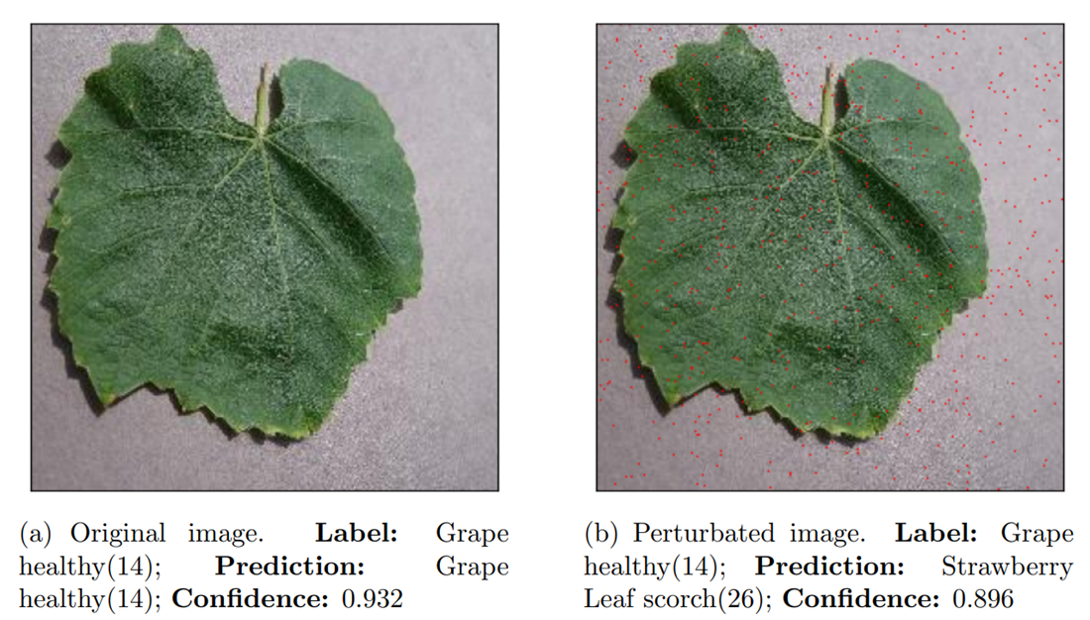
Case study 2 : Non-Homogeneous Background
600 altered pixels of the 256x256 image (0.09% perturbation).
Results: the model misclassified the perturbed image with a confidence of 0.896 as a strawberry leaf scorch, indicating that the model has merely learned a correlation between ”red/purplish” colour and leaf scorch disease.
Conclusions: XAI techniques have highlighted 1) limitation of our model in understating the specific characteristics of the leaf scorch disease and 2) challenges in dealing with images with non-normalize backgrounds.

Slide 15
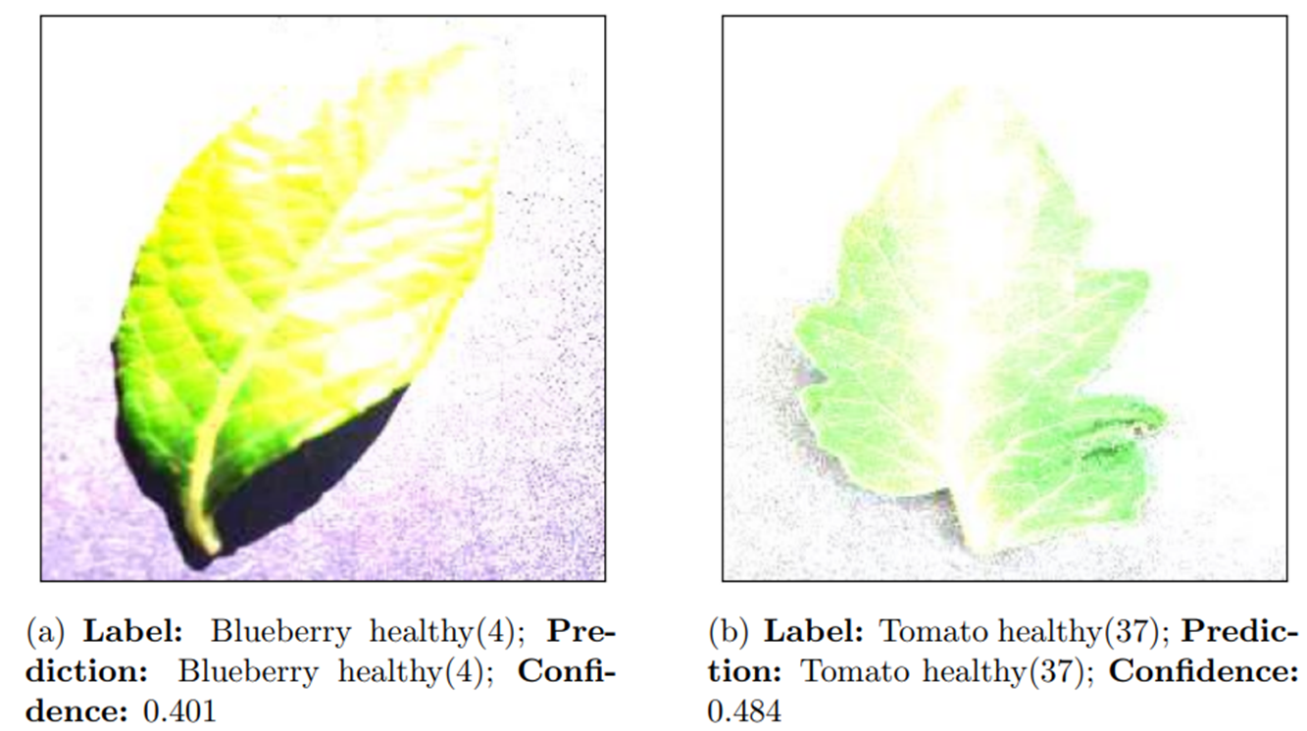
Case study 3 : Low Confidence Predictions
Motivations: why our model demonstrates low confidence for certain predictions and which features of the images contribute to this lack of confidence ?
Observation: Images with an excessively high level of brightness corresponded to the lowest prediction probabilities
Notes:
●we have found that 55 images out of the 17,572 of the validation set are classified with an output probability less than 0.7. Among these 55 images, we discovered that those with an excessively high level of brightness corresponded to the lowest prediction probabilities.
●These images exhibit a consistent visual pattern where parts of the images are clearly distinguishable, while other parts appear entirely white. It is likely that these images were generated using data augmentation techniques, as the illuminance conditions do not resemble those typically found in real-world images.

Slide 16
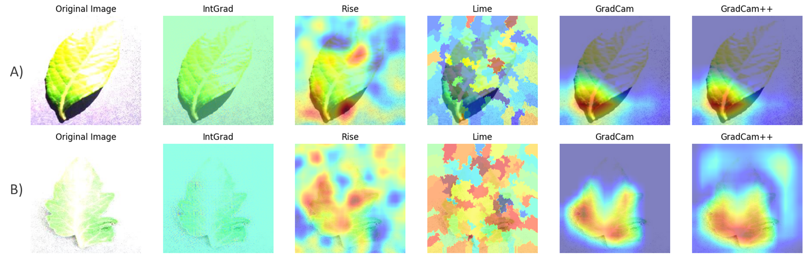
Case study 3 : Low Confidence Predictions
Results:
The model’s prediction seems to be sound even under these extreme illuminance conditions.
Guiding developers in tuning data augmentation techniques to generate images that more closely resemble real-world illuminance condition.
Guidance for end-users in classifying plants that are not well recognizable due to the low image quality.
Notes:
●Lime method fails to capture distinctive features of the leaves under analysis. The high-valued super pixels identified by Lime do not correspond to distinguishable parts of the leaves;
●IntGrad, Rise, GradCam, and GradCam++ demonstrate that the distinguishable and coloured parts of the leaves contribute positively to the model’s prediction.

Slide 17
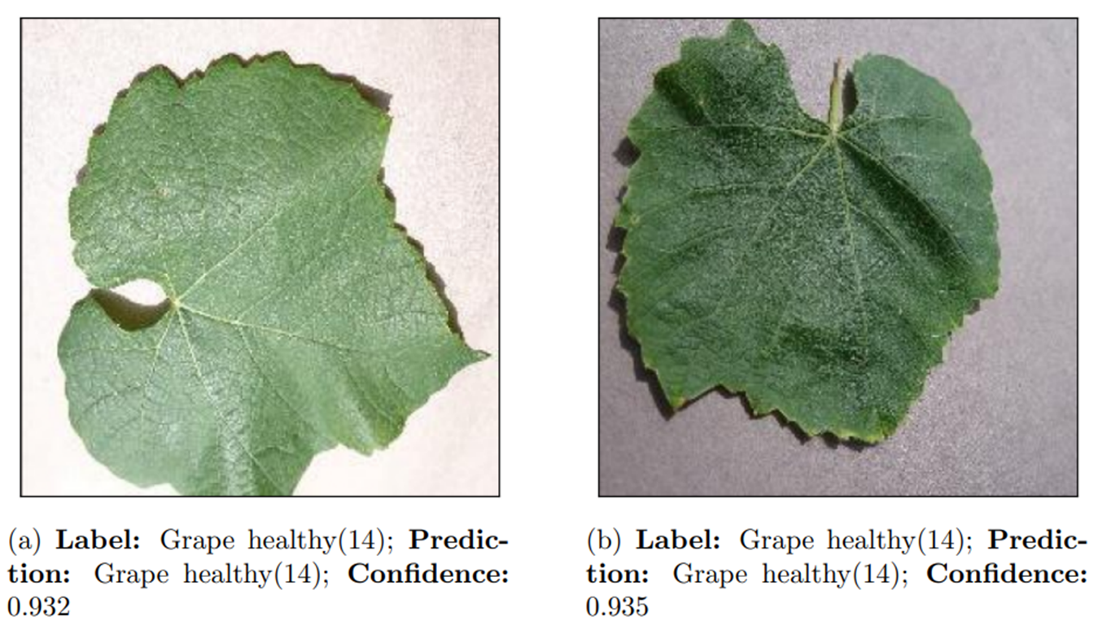
Case study 4 : High Confidence Predictions
Motivations: Given the high confidence of predictions, does the model attend to the distinctive visual traits of healthy plants?
Observation: Visual traits of Grape leaves are: heart-shaped appearance with multiple lobes with pointed tips on each lobe and serrated/toothed edges.
Notes:
●Grape leaves are known for their heart-shaped appearance with multiple lobes. They typically grow in an alternate pattern and have serrated, or toothed, edges with pointed tips on each lobe. These unique traits visually distinguish grape leaves from all other healthy leaves in the entire dataset, even for individuals without expertise in plant identification, making them particularly suitable for this case study.

Slide 18
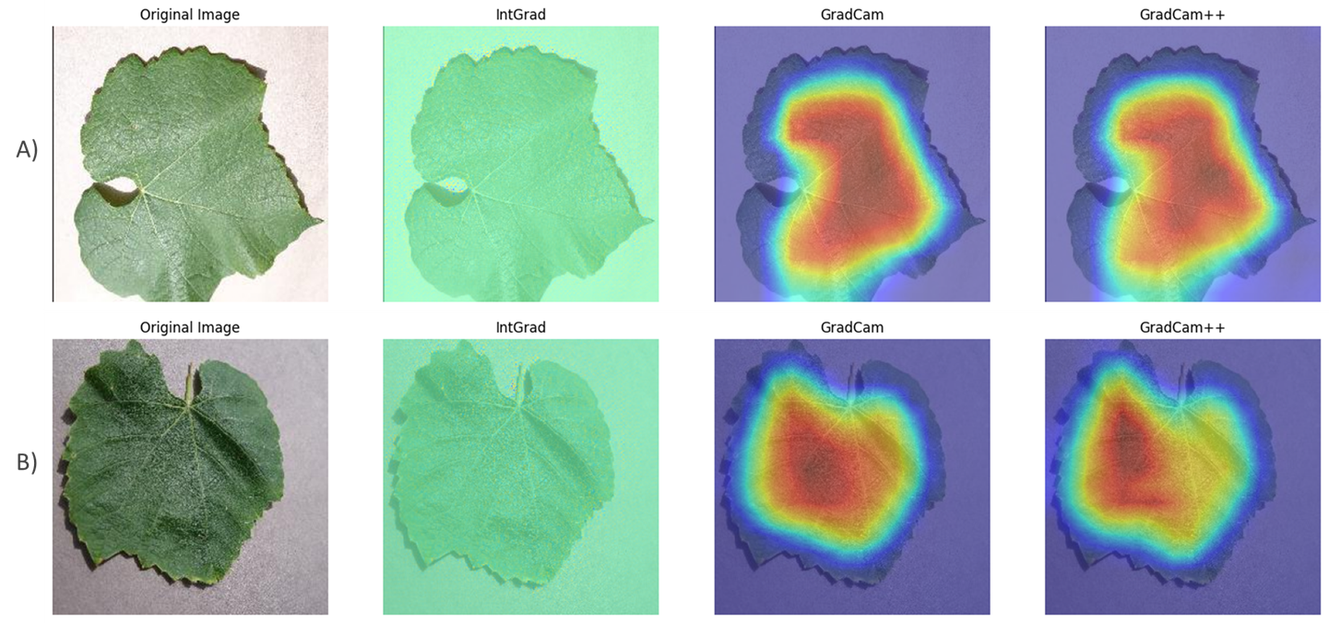
Case study 4 : High Confidence Predictions
heart-shaped appearance
Serrated/toothed edges
Pointed tip
multiple lobes
Notes:
●IntGrad primarily highlights the edges of the images, delineating the serrated contours of the leaf perimeters.
●GradCam and GradCam++ emphasize the entirety of the surface of the leaves, resulting in saliency maps with a distinctive heart-shaped pattern with multiple lobes.
●

Slide 19
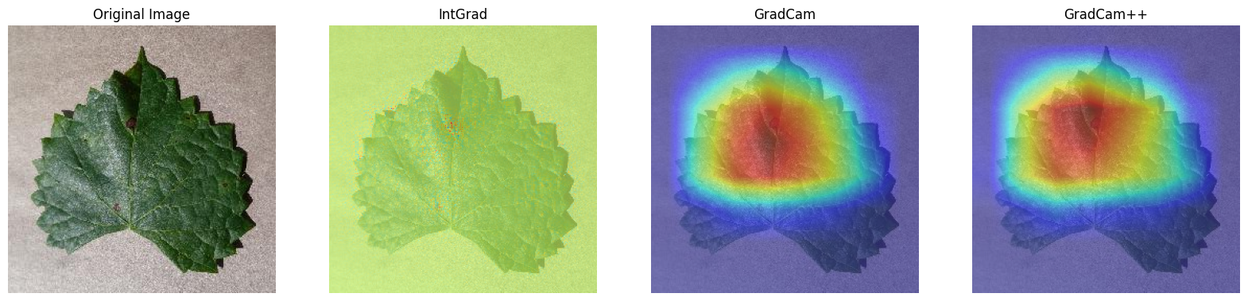
Case study 4 : High Confidence Predictions
early detection
Comparison with healthy patterns
Results and Conclusions:
Comprehensive characterization of the morphological features of healthy grape leaves.
Saliency maps can aid in the early detection of diseases on plant leaves, particularly when symptoms are not easily discernible to the naked eye.

Slide 20
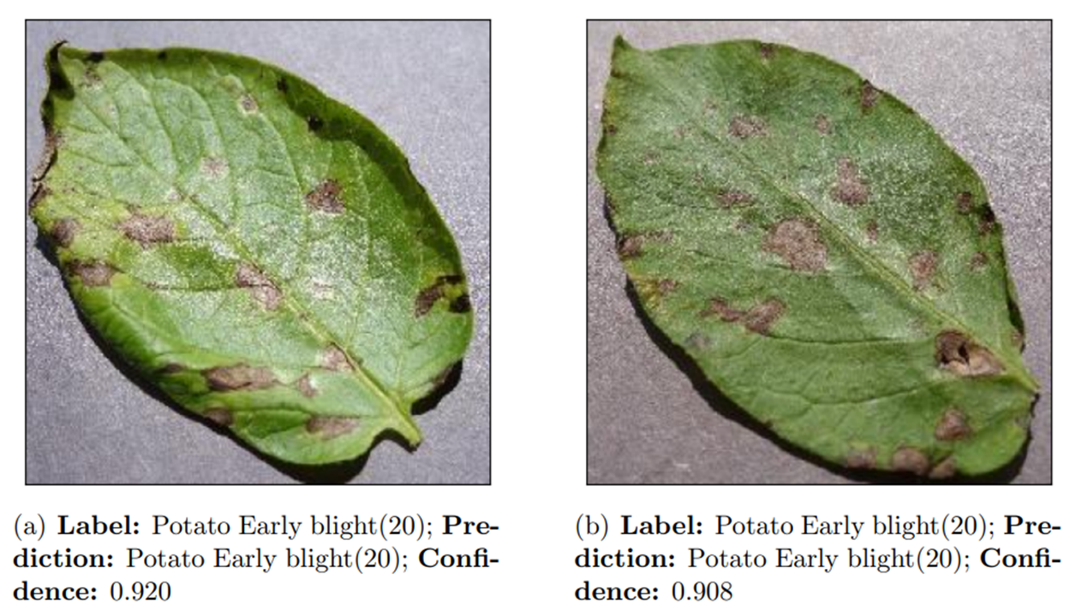
Case study 5 : Similar Images
Motivations: the objective of this case study is to assess the stability of attribution methods across two explanations, expecting similar instances to receive comparable explanations.
Observation: we evaluated these two images to be visually similar due to their common spatial orientation, leaf coloration, illuminance condition and infection stage.
Notes:
●we have found that 55 images out of the 17,572 of the validation set are classified with an output probability less than 0.7. Among these 55 images, we discovered that those with an excessively high level of brightness corresponded to the lowest prediction probabilities.
●These images exhibit a consistent visual pattern where parts of the images are clearly distinguishable, while other parts appear entirely white. It is likely that these images were generated using data augmentation techniques, as the illuminance conditions do not resemble those typically found in real-world images.

Slide 21
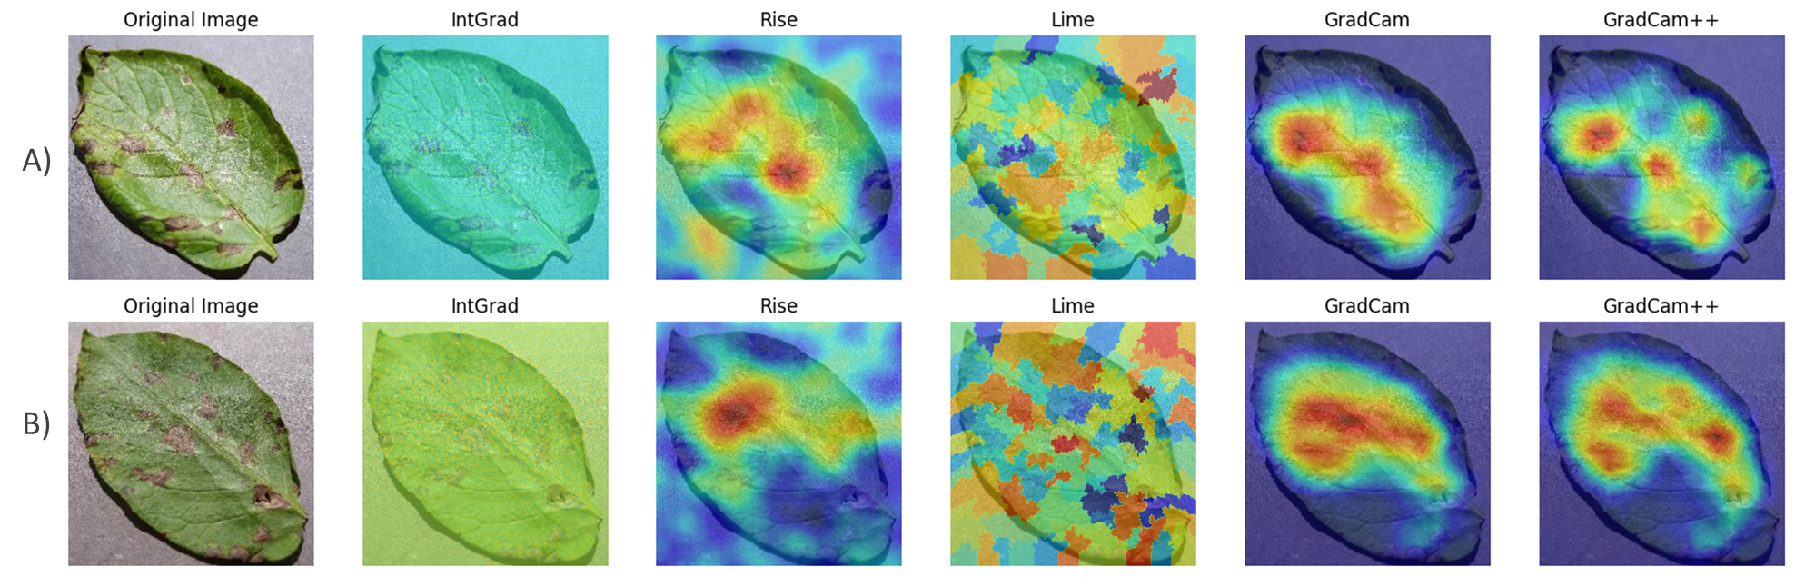
Case study 5 : Similar Images
Results and Conclusions:
The explanations provided by each attribution method for the two images are highly similar and overlapping, implying consistency in the model’s classification of early blight disease for visually similar instances.
The model primarily attends only to the major lesions on the leaves, failing to detect a substantial portion of the overall unhealthy tissue of the leaves.
The saliency maps’ explanations are insufficient for accurately locating all lesions within images, limiting segmentation of lesions pixel by pixel.
Notes:
●the explanations provided by each attribution method for the two images are highly similar and overlapping, implying consistency in the model’s classification of early blight disease for visually similar instances.
●these explanations do not adequately characterize the early blight disease affecting potato plants. it primarily attends to the major lesions on the leaves, failing to detect a substantial portion of the overall unhealthy tissue of the leaves.
●While the saliency maps’ explanations are beneficial for classification tasks providing the major visual indicators/pointers to unhealthy tissue on leaves, they are insufficient for accurately locating all lesions within images. This deficiency poses challenges for segmentation tasks, which aim to separate lesions from the background pixel by pixel, thereby impeding higher-level severity evaluations of plant diseases.

Slide 22
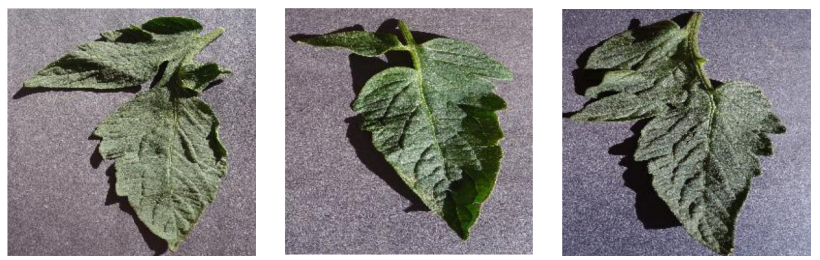
Case study 6 : Multi-leafed images
Motivations: The dataset is mainly composed by a single leaf, here we select some images from Tomato Healthy (37) which present multiple leaves in order to understand if the model is able to detect multi-leafed images, since real-world application should be able to detect even images with multiple leaves.
Label: Tomato Healthy (37) Prediction: Tomato Healthy (37)
Prediction probability: 0.91
Label: Tomato Healthy (37) Prediction: Tomato Healthy (37)
Prediction probability: 0.95
Label: Tomato Healthy (37) Prediction: Tomato Healthy (37)
Prediction probability: 0.95
Notes:
Motivations: In this case study we investigate some images from class 37 (Tomato Healthy) which present multiple leaves in order to understand if our model is able to explain multi-leafed images. We choose three images, the first two present well separated leaves, while, for the third one, the leaves are not well separated.

Slide 23
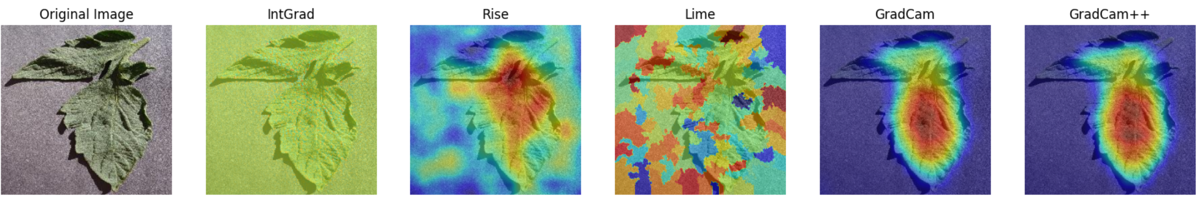
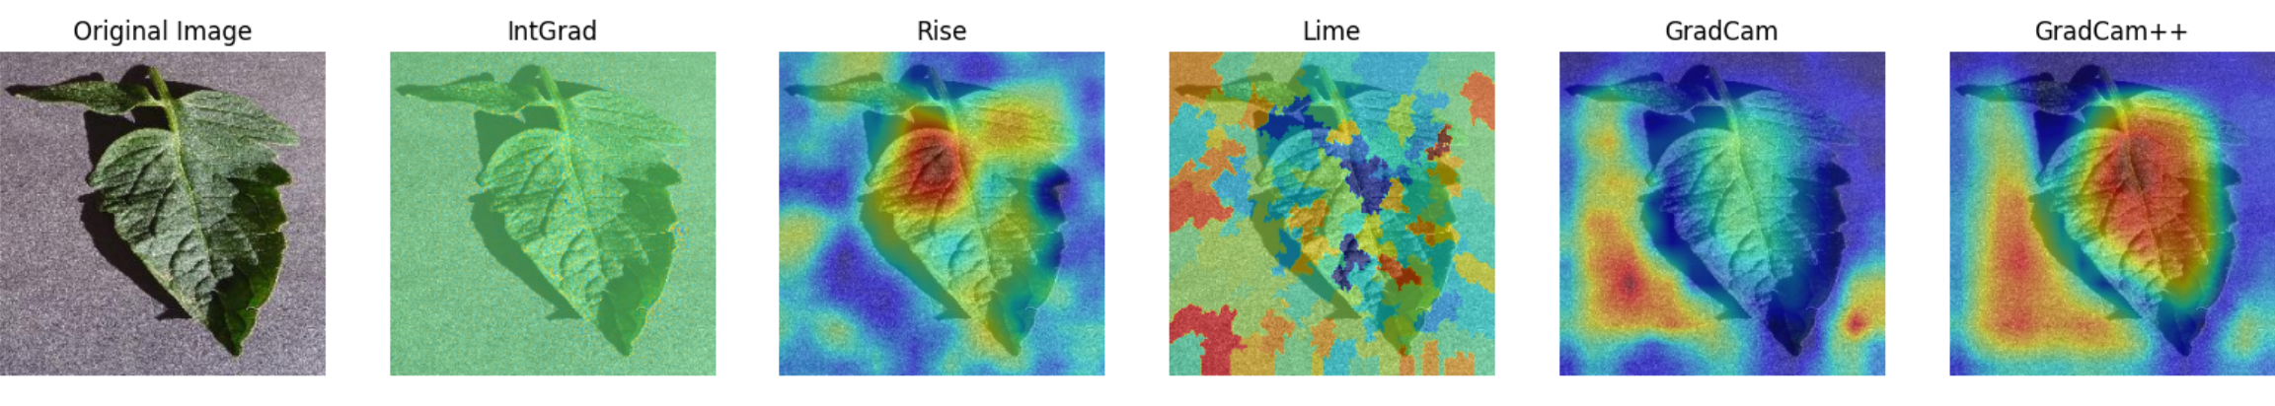
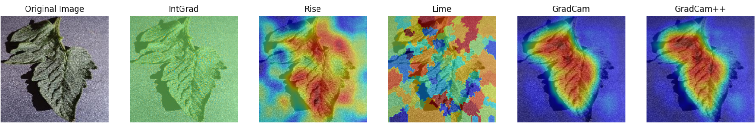
Case study 6 : Multi-leafed images
Results:
First image: RISE, GradCam and GradCam++ highlight only one leaf as representative for the prediction.
Second image: all the methods do not seem to highlight the two leaves.
Third image: RISE seems not to detect well the leaves while GradCam and GradCam++ correclty highlight the 2 leaves.
Notes:
●We can see that IntGrad and Lime seem to not highlight the discriminative parts of the image for all cases (a,b and c) As regards the other methods for case a) RISE, GradCam and GradCam++ highlight only one leaves as representative for the prediction, for case b) all the remaining methods do not seem to highlight the two leaves. and for case c) RISE seems not to detect well the leaves while GradCam and GradCam++ correclty highlight the 2 leaves.

Slide 24
Case study 6 : Multi-leafed images
Conclusions:
In some cases the model may ignore one of the two leaves, especially when they are well separated (as in the first and second images), while it seems to better recognize the two parts when they are not well separated (as in third one).
Notes:
Conclusion: this analysis suggests that in some cases the model may ignore one of the two leaves, especially in cases where they are well separated (as in a) and b), while it seems to better recognize the two parts where they are not well separated (as in c)). From a developers point of view this Analysis can be helpful to understand the limitation of the model, in particular there could be the possibility that the model have some difficulties to recognize 2 leaves present in the same image, probably also due the fact that most of images in the training set present only one leaf.

Slide 25


Conclusions and future developments
Gradcam, Gradcam++ and Rise generally carried out the most appropriate heatmaps.
Splitting the task into leaf detection and disease classification to better visualise the reasons why the model was focusing attention on a particular part of the image.
Develop a dataset with different stages of a disease. This will allow farmers to intervene in time.
Produce counterfactuals and prototypes.
Decrease the computational time to produce saliency maps.

Slide 26

Thank you for your attention!

